Slide 1
Neural Networks and Deep Learning

Slide 2
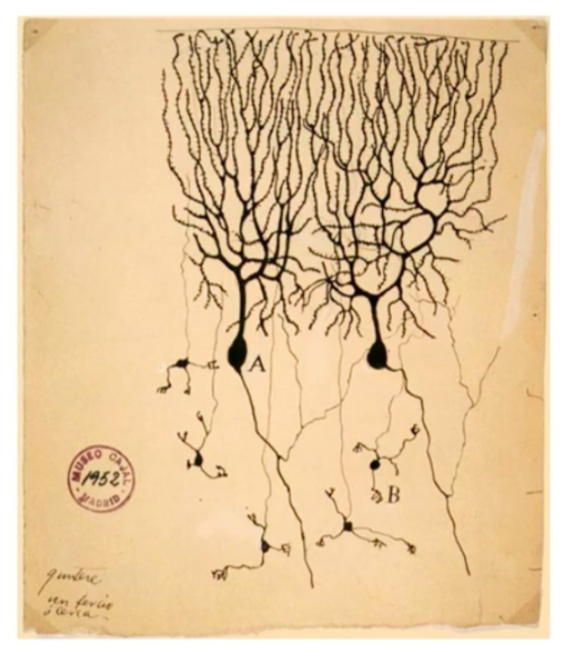
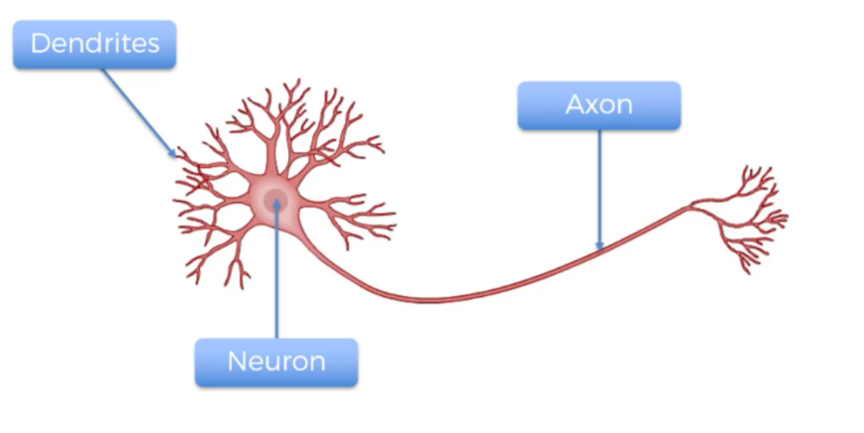
Neural Networks

Slide 3
Neural Networks
In 1943, Warren S. McCulloch, a neuroscientist, and Walter Pitts, a logician, developed the first conceptual model of an artificial neural network. In their paper, "A logical calculus of the ideas imminent in nervous activity,” they describe the concept of a neuron, a single cell living in a network of cells that receives inputs, processes those inputs, and generates an output.

Slide 4
Perceptron
Perceptron has just 2 layers of nodes (input nodes and output nodes). Often called a single-layer network on account of having 1 layer of links, between input and output.
The training of the perceptron consists of feeding it multiple training samples and calculating the output for each of them. After each sample, the weights w are adjusted in such a way so as to minimize the output error, defined as the difference between the desired (target) and the actual outputs. There are other error functions, like the mean square error, but the basic principle of training remains the same.

Slide 5
Perceptron
The single perceptron approach to deep learning has one major drawback: it can only learn linearly separable functions.
To address this problem, we’ll need to use a multilayer perceptron, also known as feedforward neural network: in effect, we’ll compose a bunch of these perceptrons together to create a more powerful mechanism for learning.

Slide 6
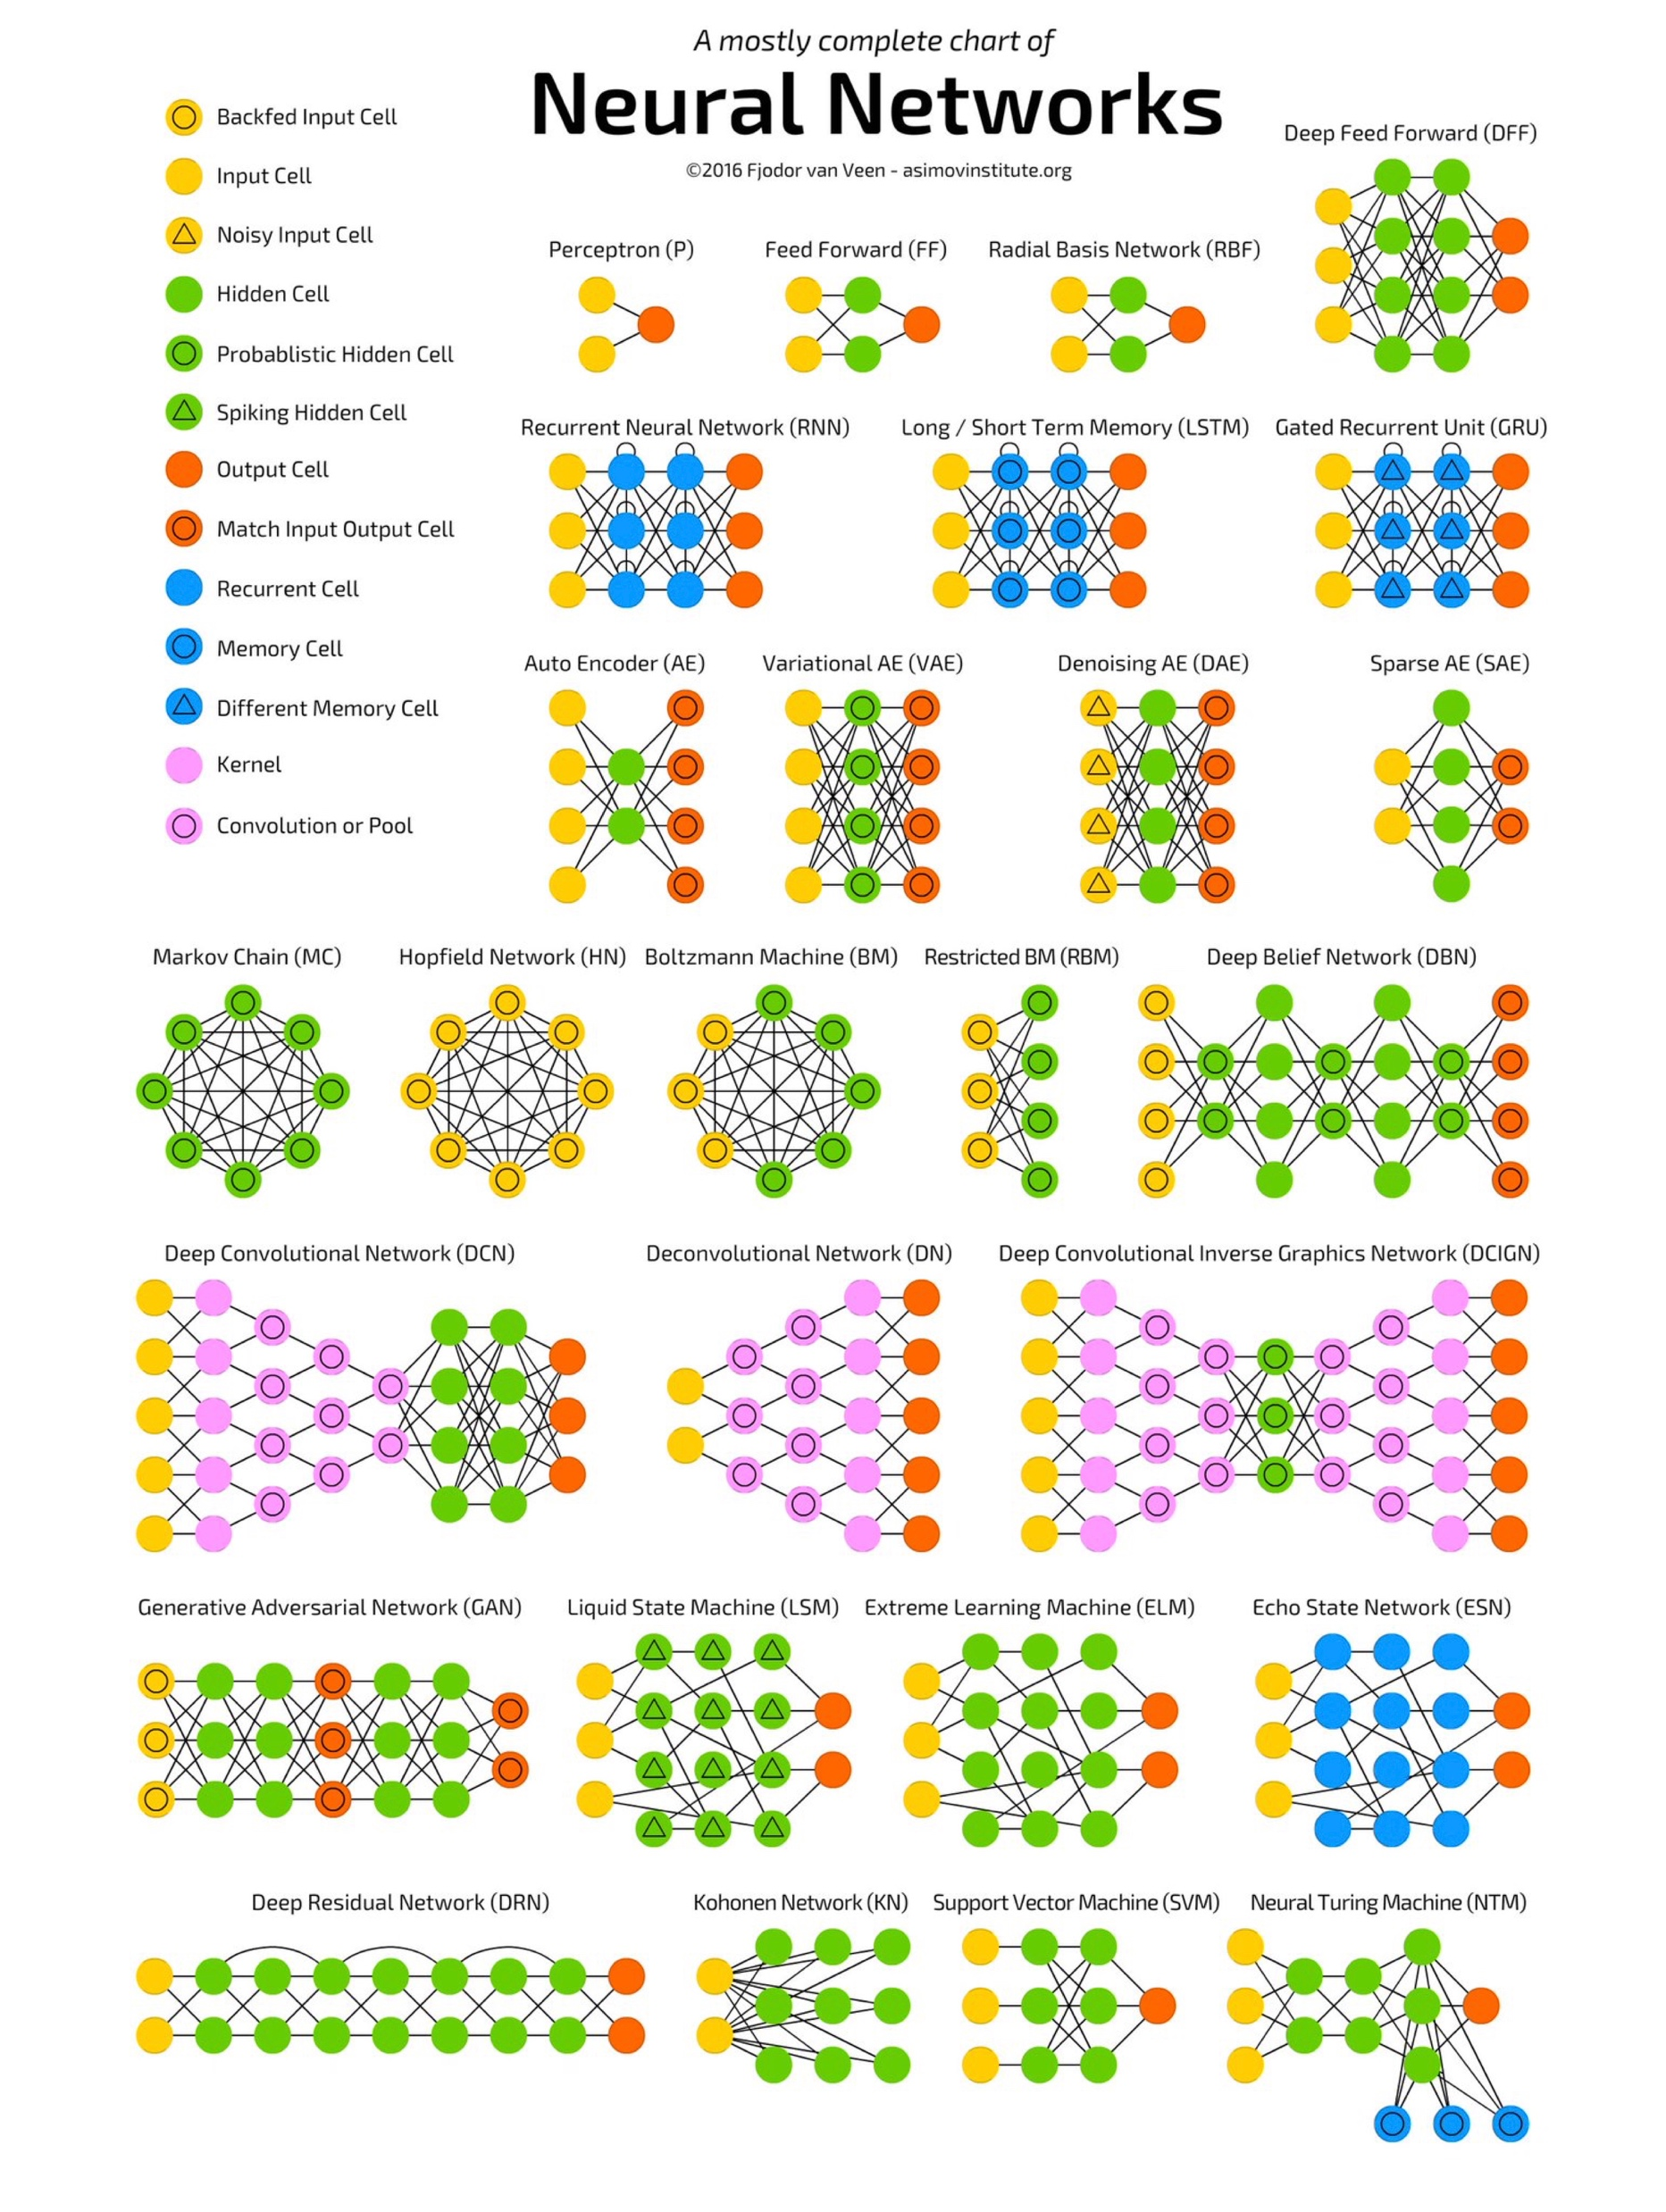

Slide 7
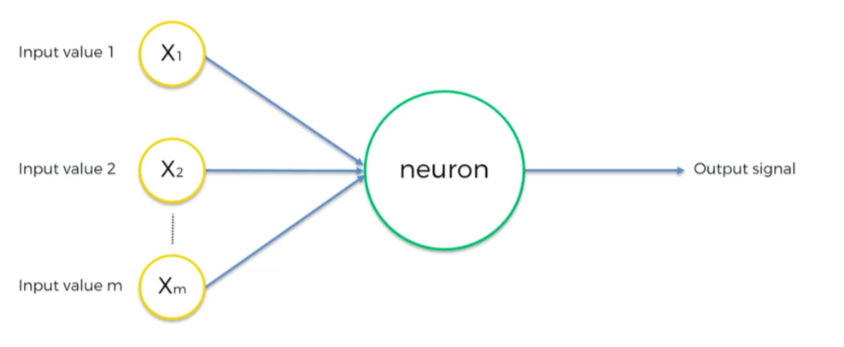

Slide 8
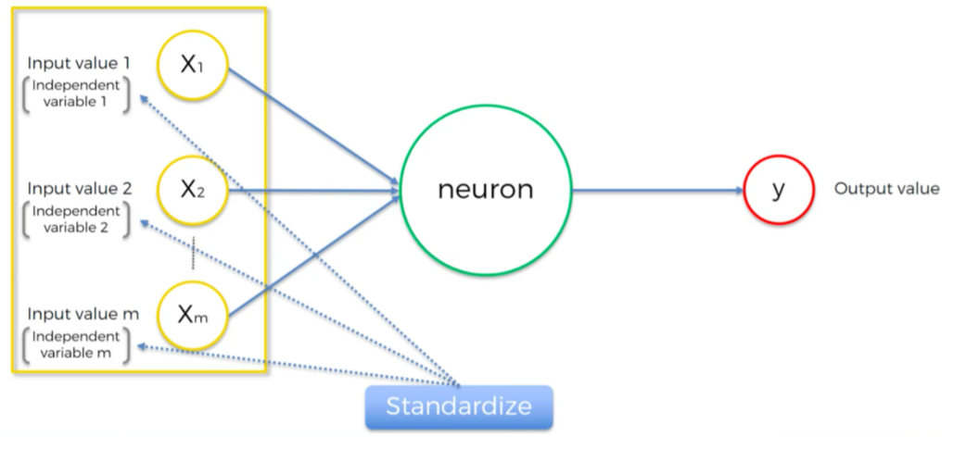

Slide 9
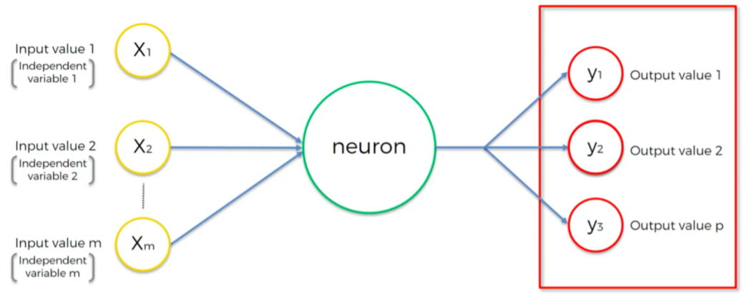

Slide 10
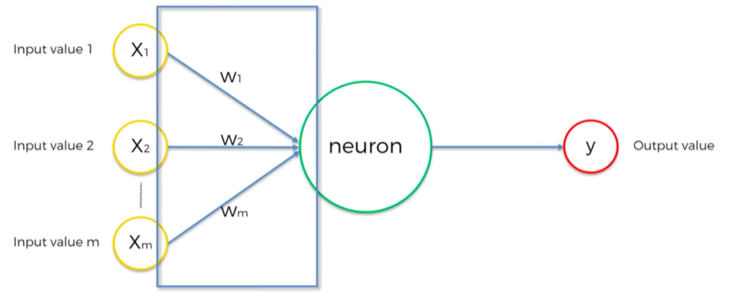

Slide 11
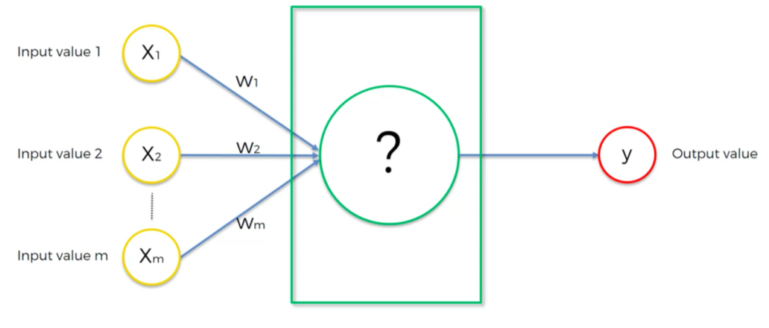

Slide 12
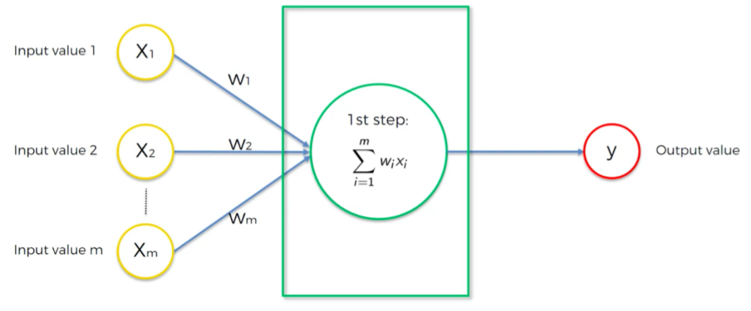

Slide 13
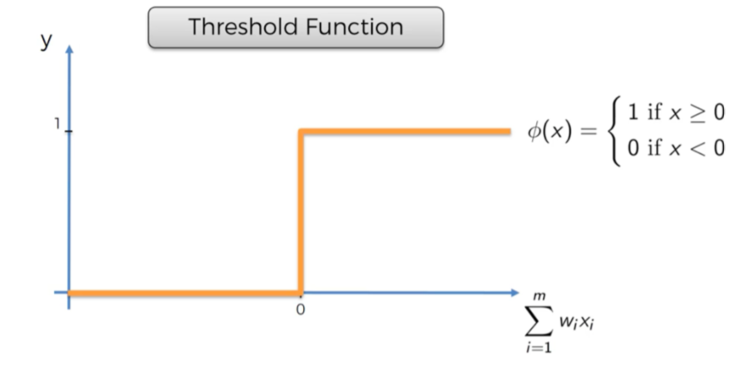
Activation Functions

Slide 14
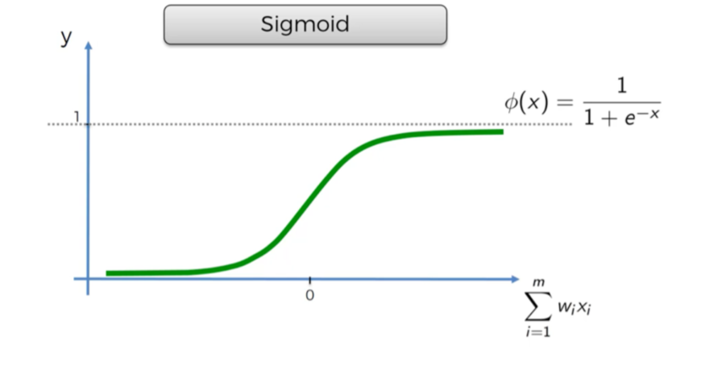
Activation Functions

Slide 15
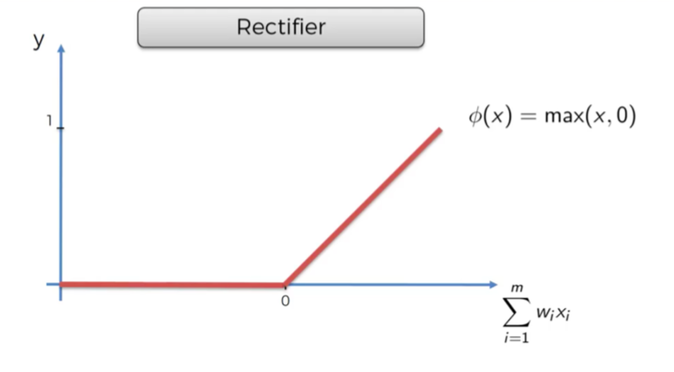
Activation Functions

Slide 16
The Problem with Large Networks
A neural network can have more than one hidden layer: in that case, the higher layers are “building” new abstractions on top of previous layers. And as we mentioned before, you can often learn better in-practice with larger networks. However, increasing the number of hidden layers leads to two known issues:
Vanishing gradients: as we add more and more hidden layers, backpropagation becomes less and less useful in passing information to the lower layers. In effect, as information is passed back, the gradients begin to vanish and become small relative to the weights of the networks.
Overfitting: perhaps the central problem in machine learning. Briefly, overfitting describes the phenomenon of fitting the training data too closely, maybe with hypotheses that are too complex. In such a case, your learner ends up fitting the training data really well, but will perform much, much more poorly on real examples.

